Slide 1
Financial Analytics - Unified mentor
Katuri Madhava Rajesh

Slide 2
Introduction:
In today's competitive business landscape, understanding the competition is crucial for strategic decision-making. This analysis focuses on the market capitalization and quarterly sales data of the top 500 companies in India, providing key insights and identifying important metrics and relationships to aid management in outperforming rivals.

Slide 3
Details of data:
Serial Number: Unique identifier for each company.
Name of Company: The name of the company.
Market Cap – Crore: Market capitalization in crores.
Sales Qtr – Crore: Quarterly sales in crores.

Slide 4
Main KPI’s:
Mean Market Capitalization: Average market value of the listed companies.
Median Market Capitalization: Median market value, indicating the middle point of market capitalization.
Total Market Capitalization: Sum of market capitalization of all companies.
Mean Quarterly Sales: Average sales revenue per quarter.
Median Quarterly Sales: Middle value of quarterly sales.
Total Quarterly Sales: Sum of sales revenue for all companies in a quarter.
Correlation between Market Capitalization and Quarterly Sales: Relationship between a company's market value and its sales performance.

Slide 5
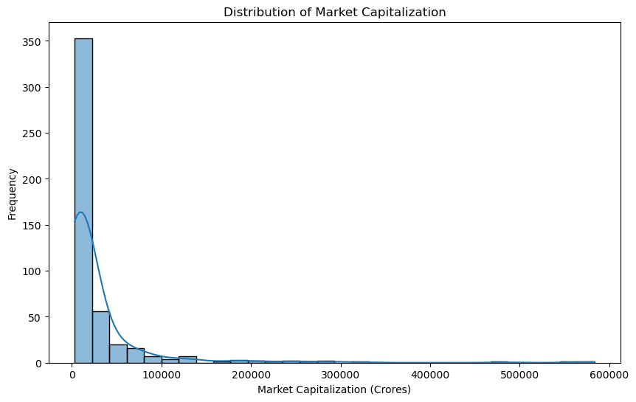
Distribution of Market Capitalization:

Slide 6
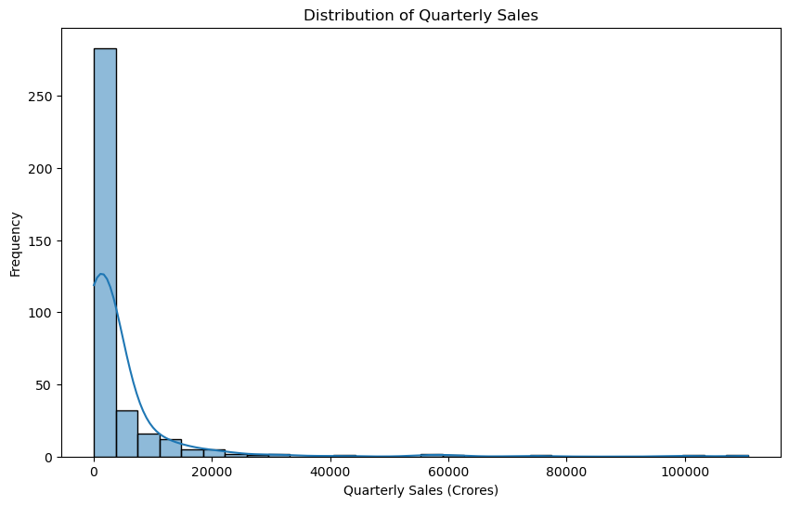
Distribution of Quarterly Sales:

Slide 7
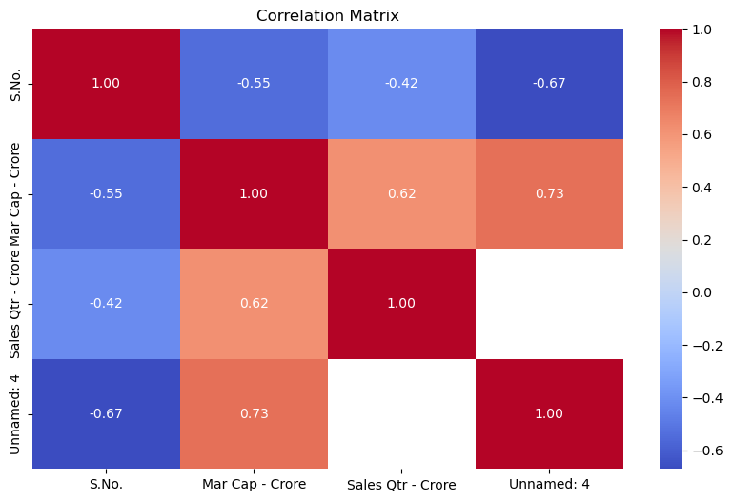
Correlation Matrix:

Slide 8
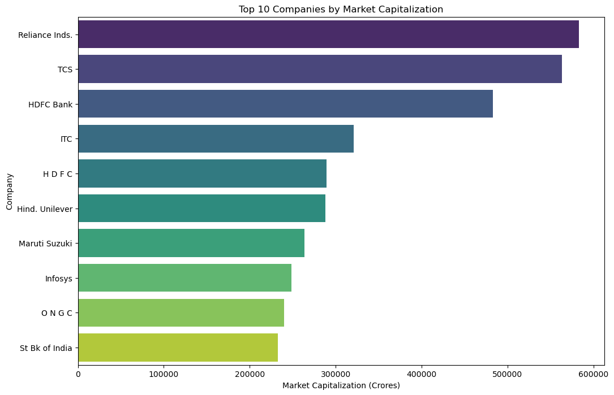
Top 10 Companies by Market Capitalization:

Slide 9
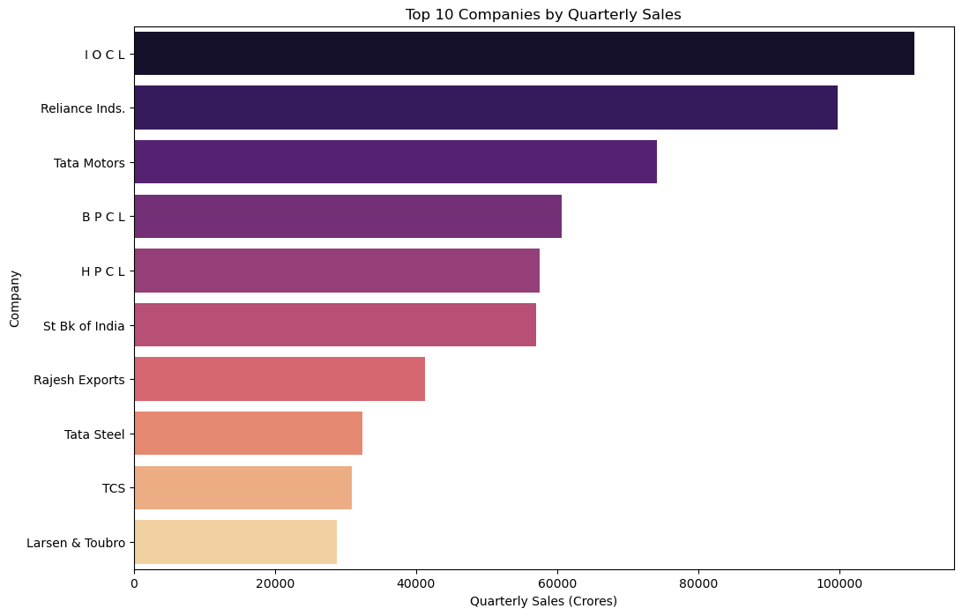
Top 10 Companies by Quarterly Sales:

Slide 10
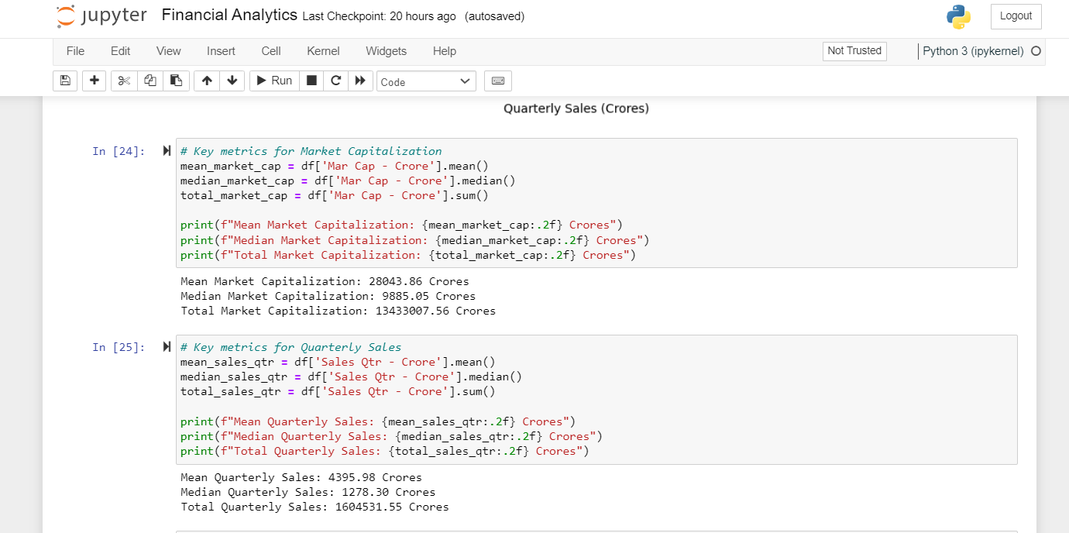
Key metrics for Market Capitalization and Quarterly Sales:

Slide 11
THANK YOU

